Slide 1

A CROSS CULTURAL COMPARISON OF THE IMPORTANCE OF LEADERSHIP TRAITS FOR EFFECTIVE LOW-LEVEL AND HIGH-LEVEL LEADERS
Author Name:
Gian Casimir (Newcastle Graduate School of Business, Australia)
David A. Waldman (School of Global Management and Leadership, Arizona State University, USA)

Slide 2
PRESENTED TO:
Miss Samina Yaqoob
PRESENTED BY:
Samia Liaqat 2021-CS-128
Iqra Rafiq 2021-CS-134
Eman Zubair 2021-CS-138
Umm-E-Farwa 2021-CS-158

Slide 3
AGENDA
Introduction
Methodology & Cultural Differences
Leader-Level Differences & Analysis
Cross-Cultural Similarities
Case Study
Conclusion & Future Directions

Slide 4
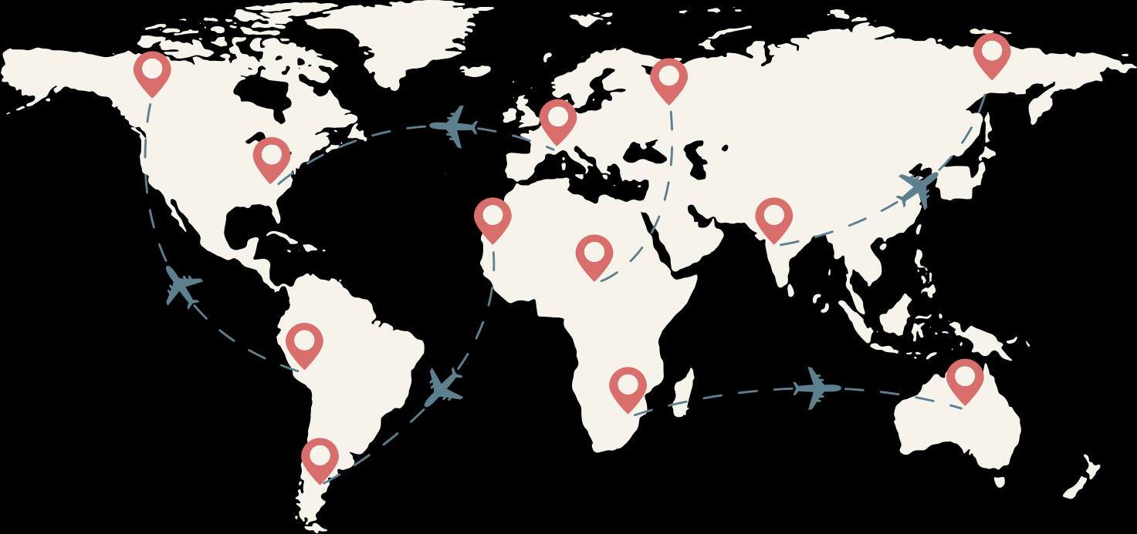


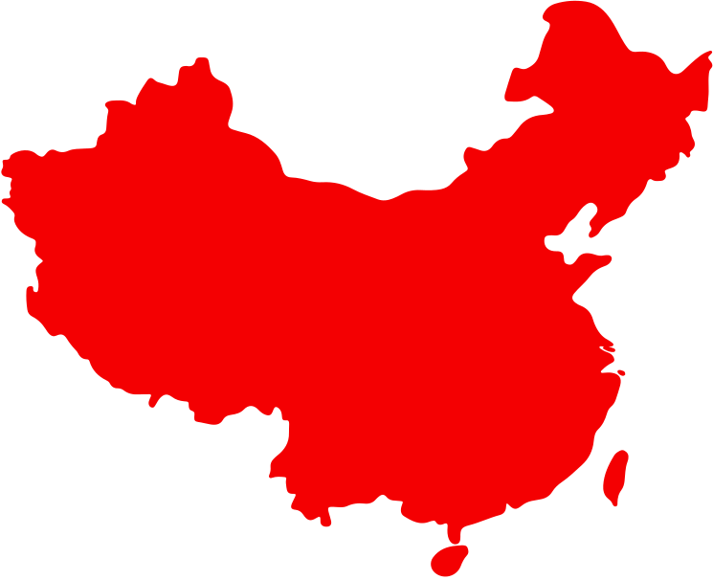
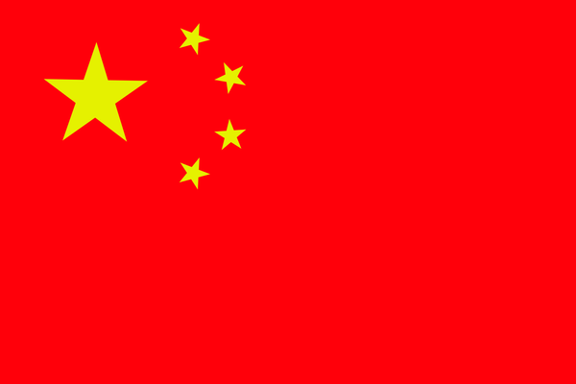
INTRODUCTION
1
Title:
A Cross-Cultural Comparison of the Importance of Leadership Traits for Effective Low-Level and High-Level Leaders
Brief Introduction:
Leadership effectiveness is influenced by cultural differences.
Different leadership traits are valued at low-level and high-level positions.
This study focuses on Australia and China to compare leadership expectations.
AUSTRALIA & CHINA
A CROSS CULTURAL LEADERSHIP STUDY

Slide 5
OVERVIEW OF THE
RESEARCH
2
Purpose:
Explore leadership traits across different cultural contexts.
Compare expectations for low-level and high-level leaders in Australia and China.
Scope:
Focuses on two culturally distinct nations: Australia (individualistic) and China (collectivistic).
Examines how cultural norms shape leadership effectiveness.
Importance:
Understanding cultural variations helps improve leadership development.
Provides insights for multinational organizations and global leadership strategies.

Slide 6
KEY CONCEPTS
3
Cognitive Prototypes & Leadership Traits
Leadership traits are shaped by cultural mental models.
People categorize leaders based on culturally accepted attributes.
Role of Culture in Leadership Perceptions
Cultural values influence how leadership is perceived and exercised.
Australia | China
Values independence, innovation, and assertiveness. Leaders and employees are seen as equals. Open communication and friendliness are highly valued. | Emphasizes hierarchy, harmony, and collective success. Clear distinction between senior and junior roles. Leadership is more authoritative and structured.

Slide 7

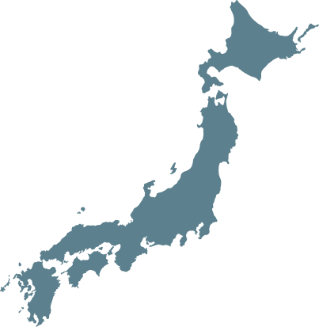
4
RESEARCH OBJECTIVE
Main Objective:
Investigate how cultural differences influence leadership traits at different levels.
Key Research Questions:
What leadership traits are considered effective in Australia and China?
How do leadership expectations differ between low-level and high-level positions?
How do cultural values impact leadership perceptions and effectiveness?

Slide 8

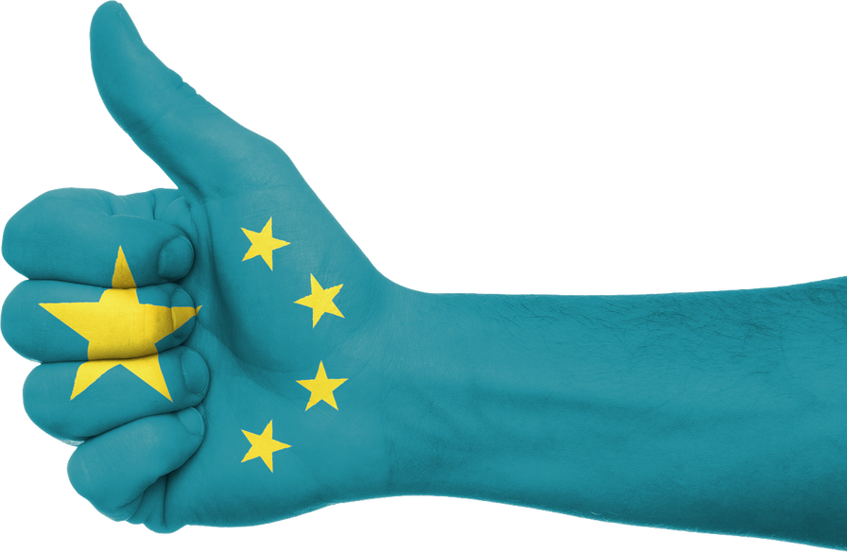

KEY FINDINGS
CULTURAL DIFFERENCES
5
Australians Preferred Leaders
Friendly
Communicative
Respectful
Humorous
Chinese Preferred Leaders
Team-oriented
Concerned
Modest
Hierarchical

Slide 9
AUSTRALIANS VS CHINESE
HYPOTHESES
6
Hypothesis 1a:
Australians will value traits that reduce power differences (e.g., friendly, respectful) more than the Chinese.
Hypothesis 1b:
Chinese will value traits that enhance collective orientation (e.g., modest, team-player) more than Australians.
Hypothesis 2a:
Transformational traits (e.g., visionary, inspirational) will be more important for high-level leaders.
Hypothesis 2b:
Operational traits (e.g., participative, team-player) will be more important for low-level leaders.

Slide 10
7
METHODOLOGY
Participants:
84 Australian white-collar employees
244 Chinese white-collar employees
Rated 18 leadership traits for low-level and high-level leaders
Measures:
Traits included inspirational, visionary, communicative, team-player, etc.
Rated on a 5-point scale (1 = not important, 5 = absolutely necessary).
Data Analysis:
Multivariate Analysis of Variance (MANOVA)

Slide 11



LOW-LEVEL VS HIGH-LEVEL LEADERSHIP
8
High-Level Leaders:
Visionary: They think about where the company should go in 5 or 10 years.
Courageous: They take risks to make big changes.
Inspirational: They energize and motivate people.

Slide 12



LOW-LEVEL VS HIGH-LEVEL LEADERSHIP
9
Low-Level Leaders:
Team-Player: They work closely with their team to solve problems.
Respectful: They treat everyone equally and value opinions.
Humorous: They create a friendly and stress-free atmosphere.

Slide 13
LEADER-LEVEL INTERACTION EFFECTS AU VS CN
10
Australian Leadership Style
High-Level Focus → Focus on Strategy & Innovation
Low-Level Focus → Focus on Team Collaboration
Power Distance → Low (Leaders & employees are close)
Chinese Leadership Style
High-Level Focus → Leadership remains the same at all levels
Low-Level Focus → Leadership is about hierarchy, harmony & respect
Power Distance → High (Hierarchy is respected)

Slide 14
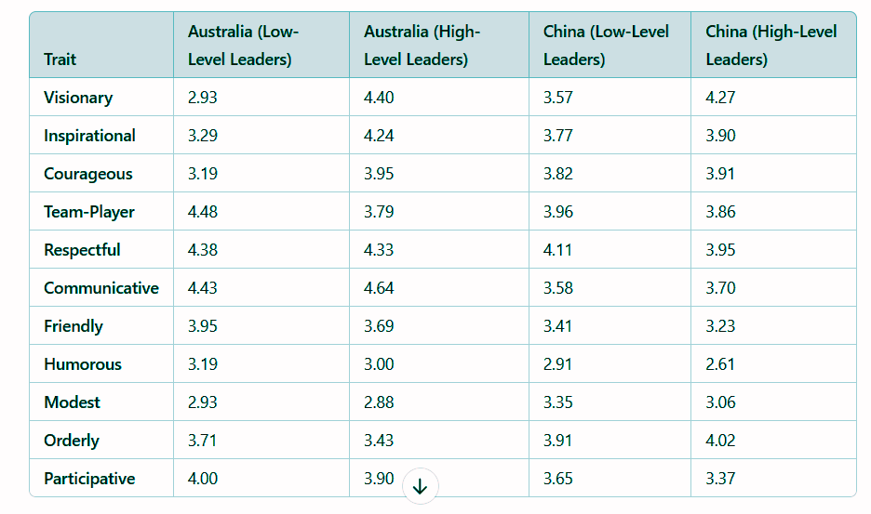
11
LEADERSHIP TRAIT RATINGS AUSTRALIA VS CHINA

Slide 15



CROSS-CULTURAL SIMILARITIES
12
Innovative: Leaders must bring new ideas to solve problems.
Trustworthy: Leaders must gain the trust of their team.
Team-Oriented: Both cultures value leaders who promote teamwork.
Innovative
Similarities
Team-Oriented
Trustworthy

Slide 16
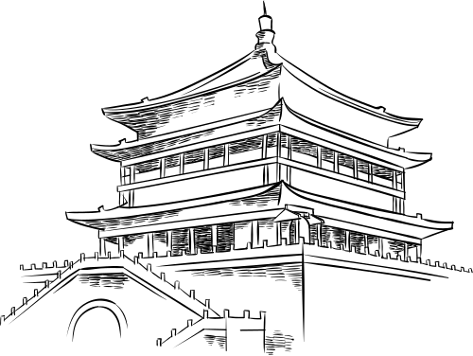



13
SUMMARY OF FINDINGS
Leadership traits are culturally contingent and role-specific.
Australia values friendly, approachable leaders.
China prefers hierarchical, modest leadership.
High-level leaders are expected to be visionary and courageous.
Low-level leaders are expected to be team players and participative.

Slide 17






IMPLICATIONS FOR
ORGANIZATIONS
14
Adapt Leadership Styles:
Leaders should adjust their approach to fit cultural expectations.
Training Programs:
Offer cross-cultural leadership workshops.
Focus on adapting to both hierarchical and egalitarian structures.
Real Life Examples:
Successful global companies like Apple, McDonald's, Google, Unilever, and Coca-Cola adapt leadership styles to fit cultural expectations—embracing hierarchy in Asia, decentralization in west, and local empowerment worldwide to ensure effective leadership across markets.

Slide 18
CASE STUDY: UBER’S LEADERSHIP CHALLENGES IN CHINA
15
Challenge: Leadership Mismatch
Uber expanded into China but faced cultural and leadership challenges.
Applied Silicon Valley-style decentralized leadership, focusing on aggressive expansion and driver incentives.
In China, business success relies on government relationships and hierarchical leadership.
Uber lacked strong leadership ties with key stakeholders, causing operational and regulatory setbacks.

Slide 19
CASE STUDY: UBER’S LEADERSHIP CHALLENGES IN CHINA
16
Solution: Adaptation and Leadership Shift
Partnered with local companies (e.g., Baidu).
Appointed local executives.
Adjusted leadership approach.
Outcome: Partial Success, But Strategic Exit
Despite improvements, Uber couldn’t compete with Didi Chuxing, which had government support and local leadership expertise.
In 2016, Uber sold its China operations to Didi after recognizing the challenges of adapting to the local leadership culture.

Slide 20
CLOSING THOUGHTS
17
Cultural Awareness is Key: Effective leaders understand and adapt to different cultures.
Blend Leadership Styles: Combine universal principles with cultural nuances.
Embrace Diversity: Diverse teams foster innovation and collaboration.
Take Action: Invest in cross-cultural training to stay competitive.
“Great leaders don’t just lead; they adapt.”

Slide 21
THANK YOU
Any Questions?

